Slide 1
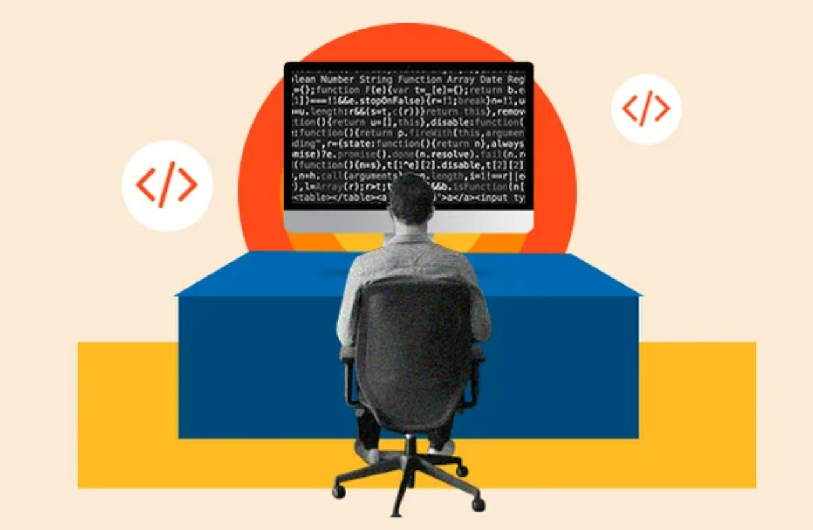
Introduction to Programming

Slide 2
What is Programming
Programming refers to a Technological process for telling a computer to perform some specific tasks, in order to solve real world problems.
You can think of programming as a collaboration between humans and computers

Slide 3
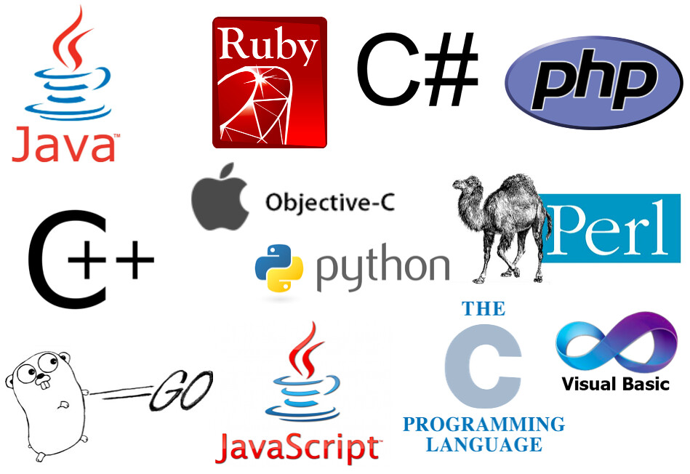
Programming Languages

Slide 4
Requirements
Interest to learn and discover new things on your own.
Time, patience and commitment.
Daily practice
Stay away from boring traditional learning methods.
Learning gradually and Sequentially.
Learn by doing (Not reading or watching).

Slide 5
What is Python
Python is a general-purpose, interpreted and a popular programming language among various industries.
Created by “Guido van Rossum” and initial version released on “February 20, 1991”.
Recently maintained by “Python Software Foundation” (https://www.python.org/)

Slide 6
Why Python?
Beginner friendly
Easy to understand syntaxes and more human readable.
Ability to use for various kinds of tasks.

Slide 7
What Python can do?
Fulfilling different phases of software development.
Developing Full-Stack web applications.
Data Science, Analysis and Scientific computing.
Machine Learning and Artificial Intelligence.
Automation.
For everyday tasks.
And much more…

Slide 8
So, can Python be used for anything and everything?
Not Really

Slide 9
Requirements to run a python program
Python software installed on any operating system. (https://www.python.org/downloads/)
A text editor or an IDE.

Slide 10
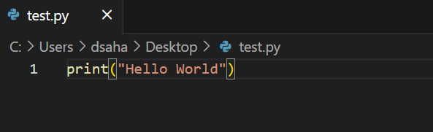
Writing your first Python Program

Slide 11
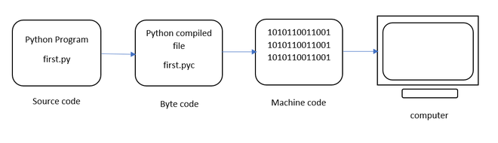
How Python code gets executed?

